Slide 1


Usama Fayyad u.fayyad@northeastern.edu
Executive Director, Institute for Experiential AI & Professor of the Practice Khoury College of Computer Sciences
An Overview of the Institute for Experiential AI
Experiential AI (EAI), GenAI, and Coping with a Rapidly Evolving Landscape
April 2024

Slide 2
The 3 waves of AI
Classical AI (waves 1 &2)
Expert systems, rule-based systems, scheduling, reasoning about uncertainty, Machine Learning
general problem solvers, heuristic search, knowledge representation, planning, causal reasoning, machine vision, natural language understanding, Pattern Recognition
Predictive AI (waves 2+ and 3)
Empirical/Data-Driven methods - data mining/data science, Deep Learning
Optimization-driven approaches,
predictive analytics, decision trees, Bayesian Models, and many classification and regression methods, Linear & Integer programming, intensive search, advanced satisfiability search and optimization
Generative AI
(wave 3)
The generation of “content” (text, images, voice, video, etc.) from a textual or multimodal prompt
Analyzes and learns from data to create (“generate”) something new - data, images, sounds, or other types of information.
Recent buzz driven by the simplicity of new user interfaces for creating high-quality text, graphics, and videos within seconds (e.g. ChatGPT)
Notes:
Generative AI is a step change in the evolution of artificial intelligence. As companies rush to adapt and implement it, understanding the technology’s potential to deliver value to the economy and society at large will help shape critical decisions.

Slide 3
How does GenAI fit within AI, Machine Learning
Artificial Intelligence
Programs with the ability to
simulate human intelligence
Applied ML
Supervised Learning
(Predictive AI)
Unsupervised Learning
Machine Learning
Programs with the ability to learn without being explicitly programmed
Generative Models
Programs with the ability to learn how to generate new data that is similar to a given set of training data
Reinforcement Learning
Gen AI
Notes:
Generative AI is a step change in the evolution of artificial intelligence. As companies rush to adapt and implement it, understanding the technology’s potential to deliver value to the economy and society at large will help shape critical decisions.

Slide 4

The Lost Themes: Data and the Human-in-the-Loop
Data is Essential
Human Intervention is Essential
Must capture
Must capture
Events
Outcomes
Context
Guidance
Corrections
Context
most organizations struggle with the basics of making data work as an asset
Capitalize on and capture every human intervention to guide AI
The “AI-haves” understand this and they have systems to:
Capture every bit of data + context
The ability to leverage this data through Machine Learning (ML) to automate the determination of the right action in the proper context
What about the human-in-the-loop? Human intervention is the most valuable asset for Google, Open AI, Amazon, Tesla, and all companies that make AI work

Slide 5

What is Experiential AI?
Human-centric approaches to solve real problems in real contexts with a human in the loop emphasis to determine how AI can work with humans most effectively.
Human intervention is a great opportunity for knowledge capture & ML
Human intervention is a must
Thesis: Taking an applied approach is the best way to solve problems in science and in practice:
Leverage data in a way that amplifies the values and benefits of machine learning
create mechanisms for machines and humans to learn together
Result: creating actions, decisions, & results that neither machine nor humans can achieve alone.
Notes:
https://docs.google.com/presentation/d/1gVSqUBMjxto7_Fd0SE9oixT21IKHowuQASqgk99vhbw/edit#slide=id.g22b1ff92866_0_43

Slide 6
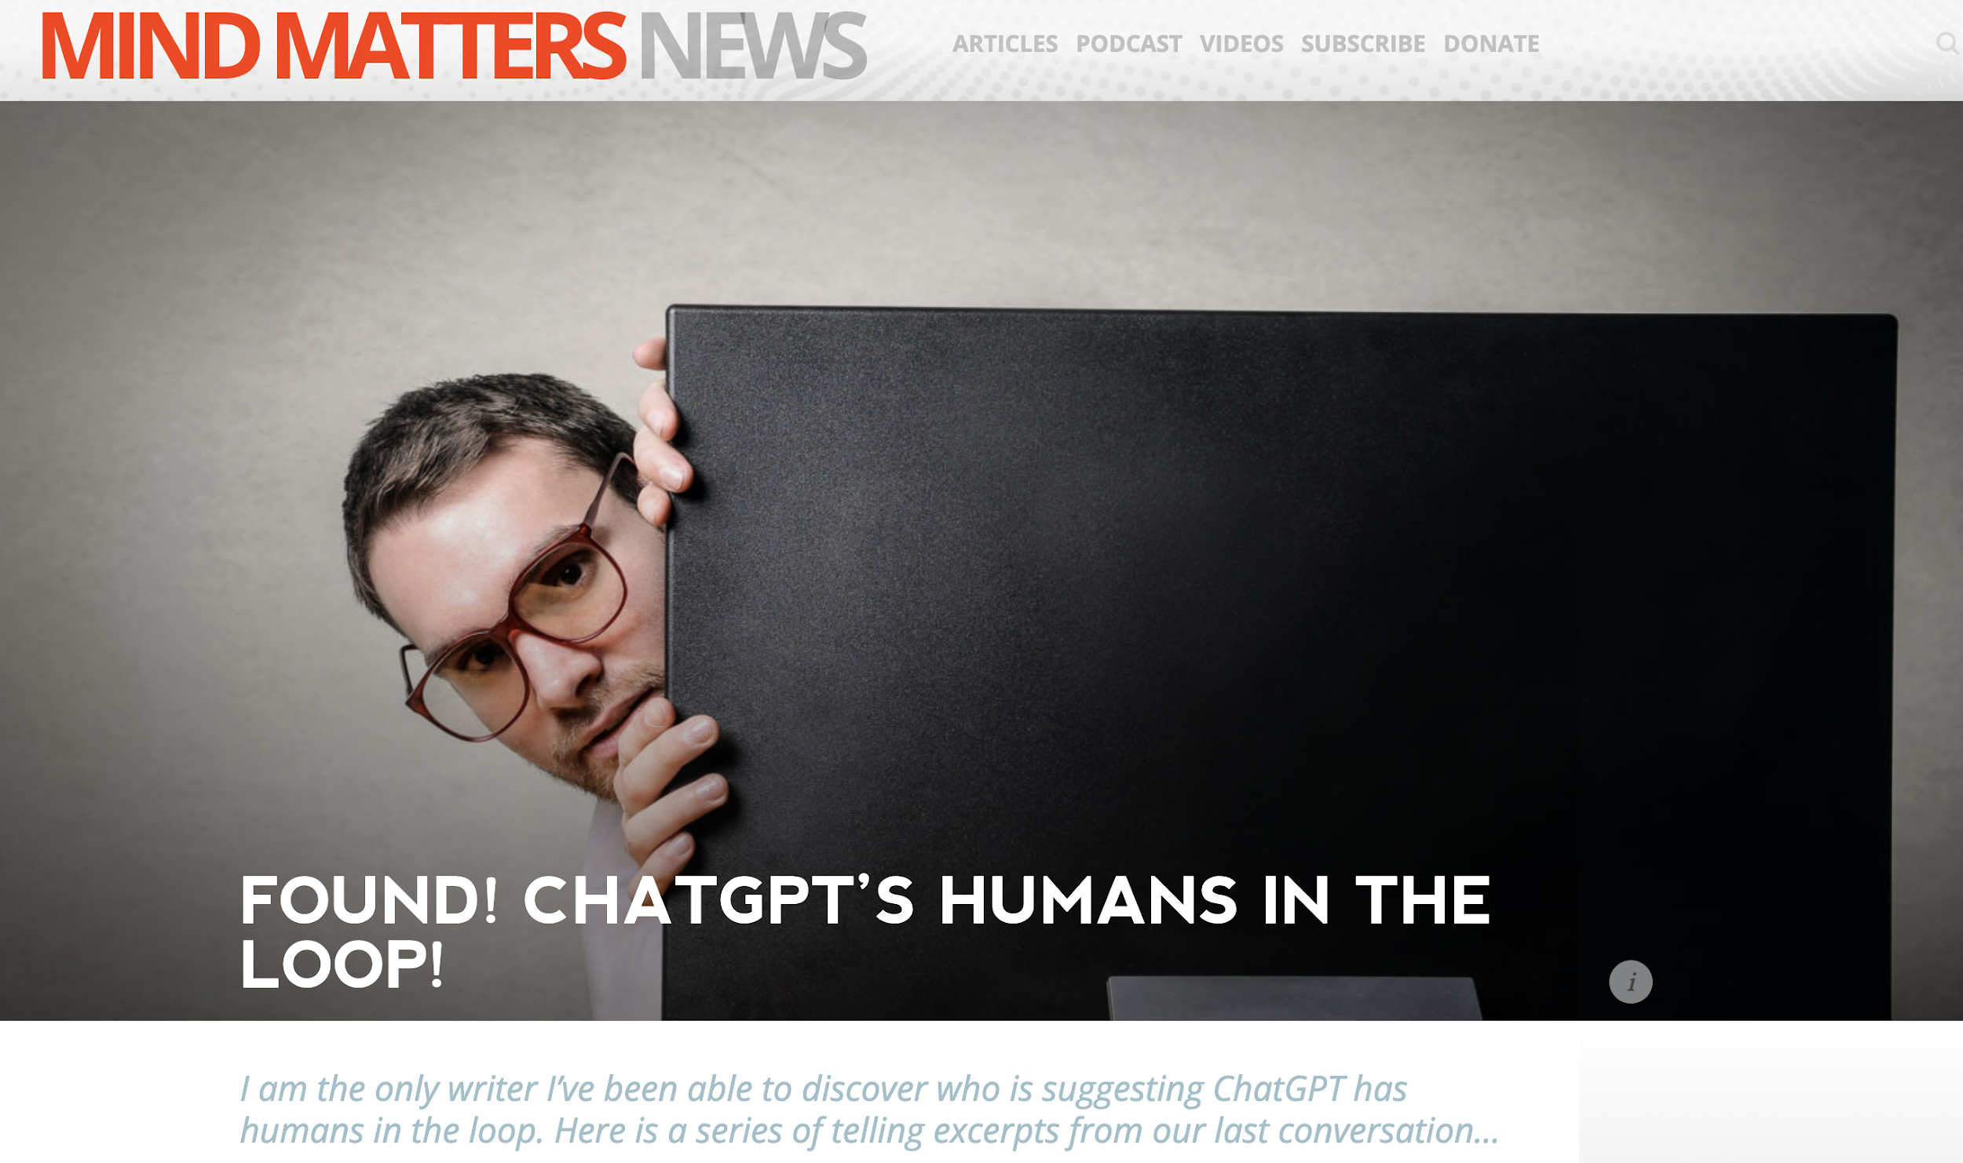
Is There a Human in the Loop (HITL) in ChatGPT?
Much speculation about pure AI (AGI) or much human intervention?
Strong evidence that human editorial review is applied
Some questions are answered by humans
Generally, this is a good sign in our opinion
Does raise issues about “intelligence” and “reasoning”
This is a best practice – we call it Experiential AI – many do it:
Google MLR
Amazon recommendations
Many intervention-based relevance feedback
https://mindmatters.ai/2023/01/found-chatgpts-humans-in-the-loop/

Slide 7
Why Generative AI
Why the Confusion?

Slide 8
What is Generative AI?
Generation of text, images, etc. from a textual or multimodal prompt
Generating text is based on Large Language Models (LLMs)
These models are sometimes referred to as “stochastic parrots” because they do not understand what they say
Other models generate images or videos

Slide 9
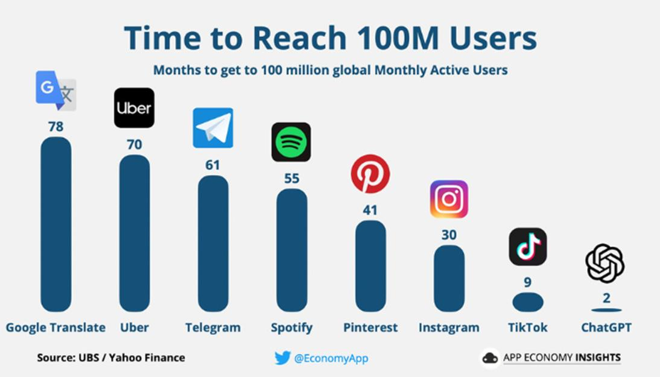
Speed of Adoption

Slide 10
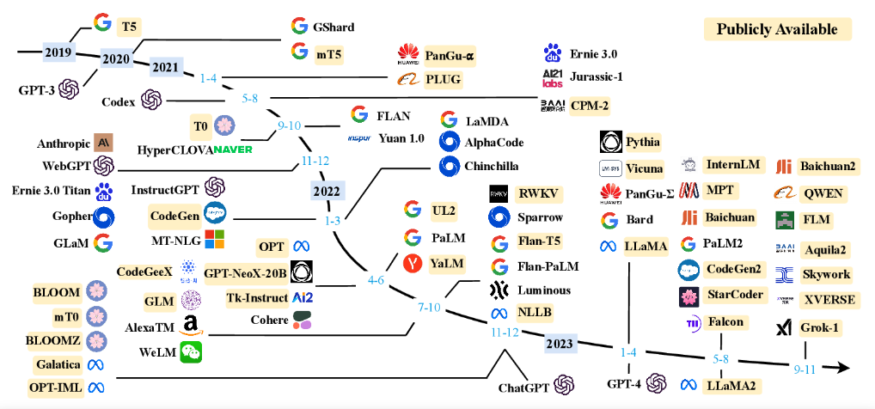
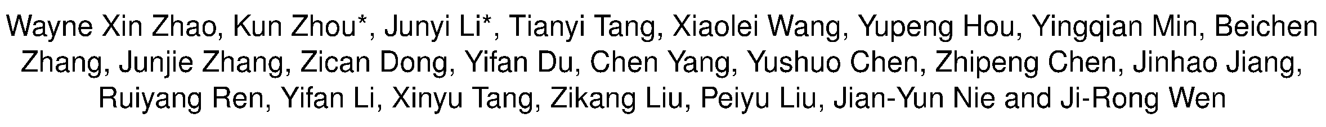
A Survey of Large Language Models
Slides adapted from Primer Talk by Prof. Byron Wallace, Northeastern University - Generative AI Workshop: From the Classroom to the Economy - April 2023

Slide 11
Economic Impact
Knowledge worker tasks
Several estimates, ranging from 15% to 80% of the work likely to experience significant acceleration
But total automation not in reach
Between 19.6% and 30.4% of global employment (ILO, 2023)
What is the size of the “knowledge economy”?
Percent of Knowledge Economy
High Income Countries | 35-54%
Upper-middle Income Countries | 22-54%
Source: U.N. Report: “Automation hits the knowledge worker: ChatGPT and the future of work” https://sdgs.un.org/sites/default/files/2023-05/B59%20-%20Berg%20-%20Automation%20hits%20the%20knowledge%20worker%20ChatGPT%20and%20the%20future%20of%20work.pdf

Slide 12
Jobs Impact
Human in the Loop is Essential
Need to check the output
Need to modify and edit
Need to approve
Will AI replace my job?
NO - but a Human using AI will
… if you are not using AI

Slide 13
The bottom line?
A Large Language Model - has no knowledge or understanding of what it “learned”
Billions to trillions of weights
They serve as a glorified “auto-complete” capability
It is amazing & astounding what these stochastic parrots can do!
In our new digital knowledge economy!
How does it work with trillions of parameters?
Ask me and we can explain it in 10 slides!

Slide 14
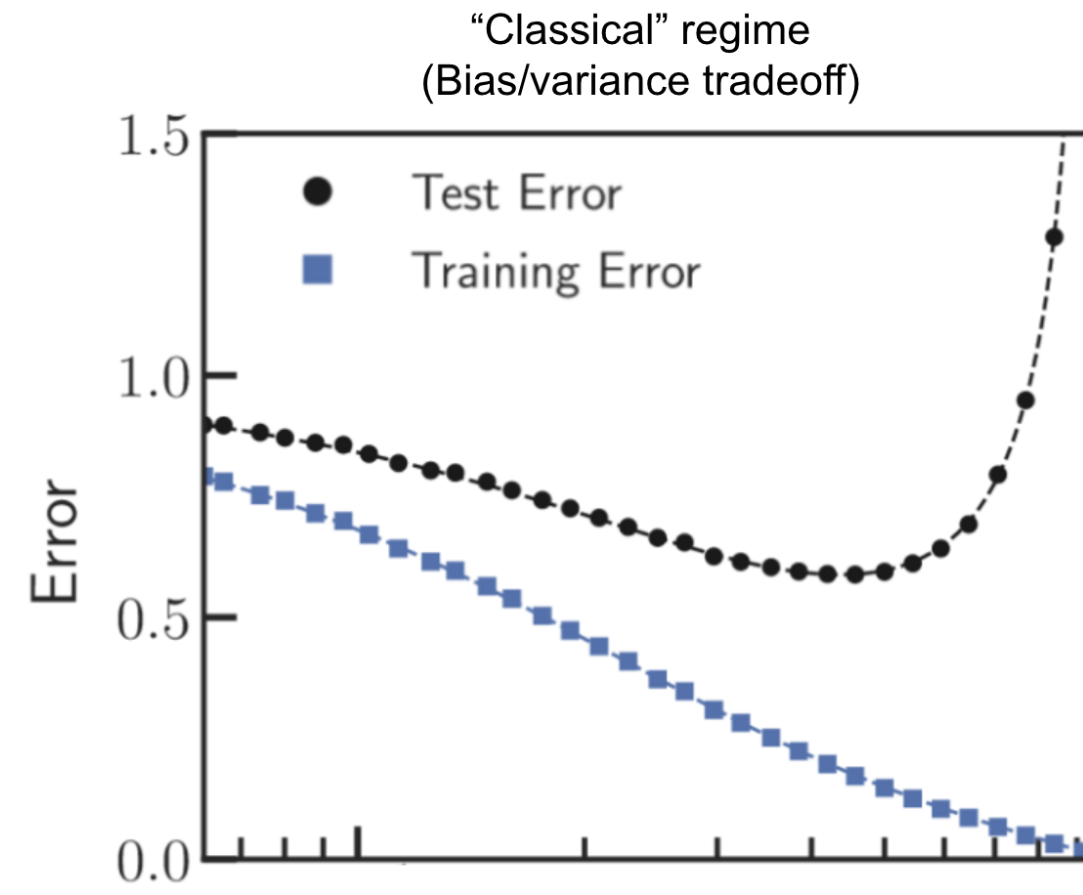
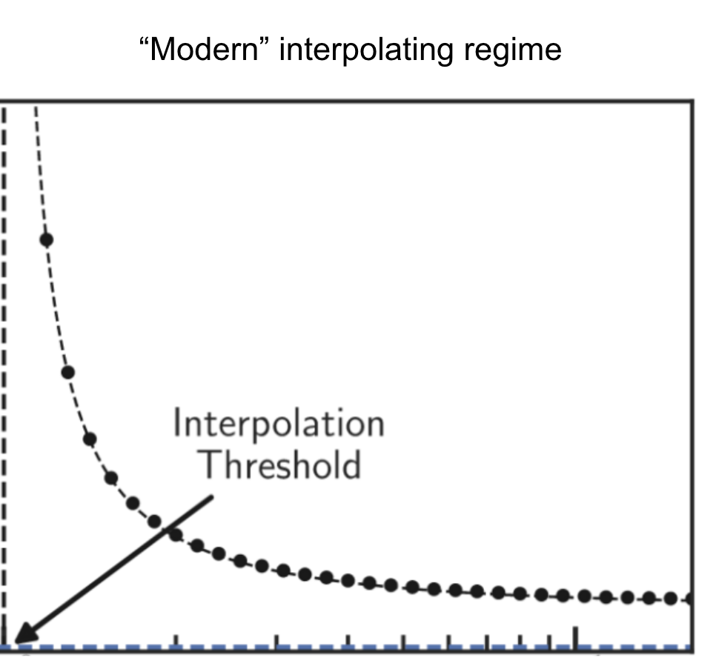
“Sweet
spot” ?
Number of Parameters
Memorizing without overfitting: Bias, variance, and interpolation in over-parameterized models Jason W. Rocks and Pankaj Mehta - arXiv:2010.13933v4 [stat.ML] 24 Feb 2022

Slide 15
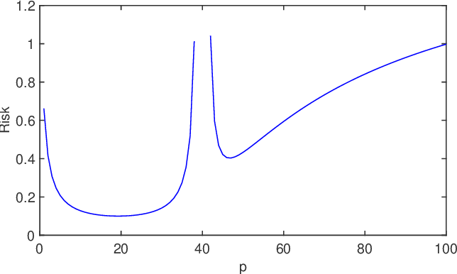
Two models of double descent for weak features Mikhail Belkin, Daniel J. Hsu, Ji Xu Published 18 March 2019 Computer Science SIAM J. Math. Data Sci.

Slide 16
Technical Challenges that Need Attention
Understanding when the black box approach works and does not work
Prompts and the dependency on them:
Prompt Engineering, or Incantations and Black Magic? (Byron Wallace)
How do these models work? and how do they fail?
What is the “right-size” model
Incorporation domain knowledge in the process (other than chatbot corrections)
Hybrid Language Models
Better Together approach (K. Church et al 2023)
Extending to GenAI in General
Responsible AI for Generative Models

Slide 17
Overview of the
Institute for Experiential AI

Slide 18
Overview of the Institute
The Institute was funded in 2021 by a combination of central funding and partially through two major donor grants (biggest being from the Roux Institute)
Goal: to build the top research institute in Experiential AI addressing research concerned with advancing the science and technology of complementing human intelligence with machines and optimizing machine intelligence through human guidance/intervention.
We seek the context of solving real problems with real constraints to:
Abstract a research agenda from real applications
Use the practical solutions to create experiential learning opportunities for students
Develop new and unique areas of focus

Slide 19







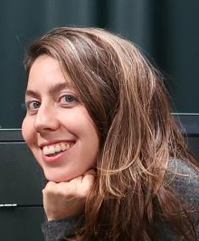
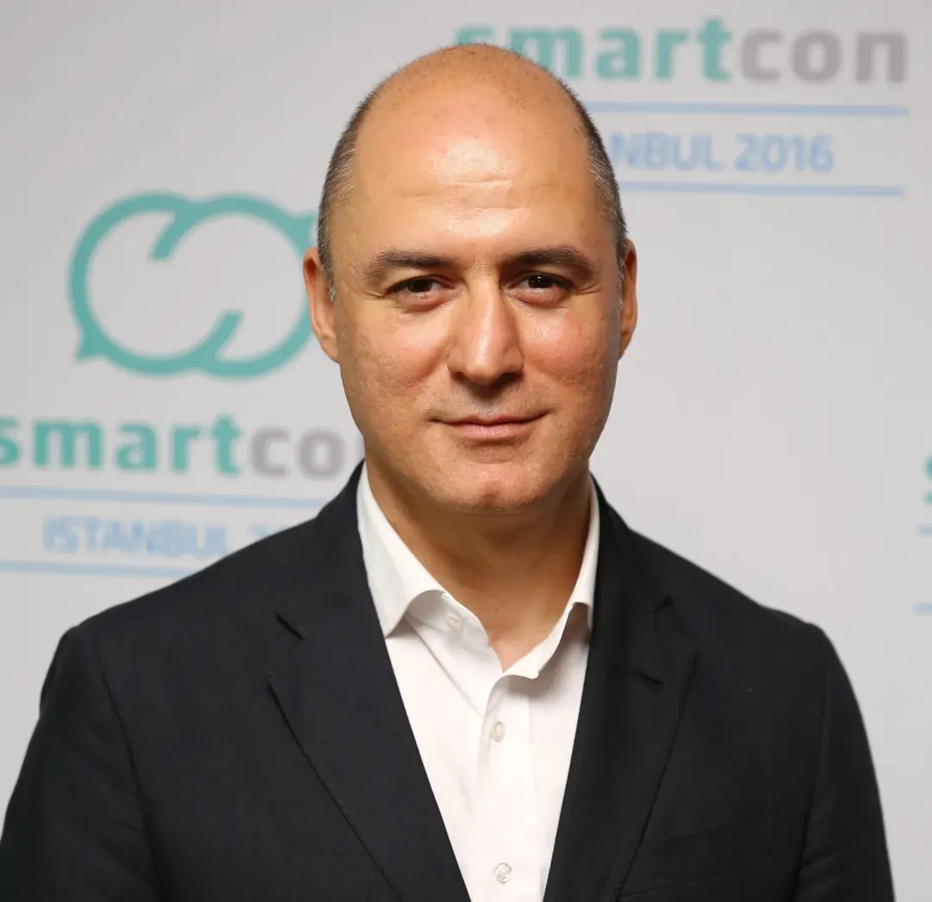

The Institute in Numbers
ACADEMIC LEADERSHIP TEAM
Academic Tenure Track:
80+ Core Faculty members
30+ Affiliate Members
Across all 9 colleges at Northeastern
Research Faculty & Scientists:
20 Research Scientists or Research Faculty (growing to 80+ target)
30+ Postdocs advancing the state-of-the-art in EAI in context of solving real-world problems
AI Solutions Hub: Staff of professionals for project delivery
Responsible AI Practice: Staff of professionals and faculty/researchers
Dr. Usama Fayyad
Executive Director
Dr. Sam Scarpino
Director, AI + Life Sciences
Prof. Eugene Tunik
Director, AI + Health
Dr. Ricardo Baeza-Yates
Director of Research
Prof. Jennifer Dy
Director of AI Faculty
Prof. Auroop Ganguly
Director, AI4CaS (Climate & Sustainability)
Dr. James Shanahan
Director of AI Solutions Hub
Dr. Cansu Canca
AI Ethics Lead
Hamit Hamutcu
Director of Strategy, Marketing and interim Educational Curricula

Slide 20
Research
Research Focus Areas
Core AI
AI+Life Sciences
AI+Health
AI4CaS
Responsible AI
Drug Discovery, Reduce time to market, confidence in therapeutics
Novel biomolecules, wet lab-in-the-loop, multi-omics, and global health security
Remote Sensing Healthcare, IOT, Wearables, AI in Diagnostic Medicine Digital Health
(digital pathology)
Hyperlocal models of climate, Risk Assessment, Adaptive models, sustainability/impact models
Hybrid Language Models (Smart Search)
Core Support for Research Focus Areas

Slide 21

The Institute For Experiential AI at Northeastern University
We aim to build a new approach for how AI is done in academia: highly applied AI Solutions Hub to work with companies on solving real problems under real constraints and conditions.
AI Solutions Hub: Staff of professionals for projects delivery
Responsible AI Practice: Staff of professionals and faculty/researchers
Drive Technology Practice
Set the Research Agenda
Identify Risks, Algorithmic Audits
Determine the Learning Curriculum

Slide 22
Large Vs. Hybrid Generative Models
Large Language Models
Very wide scope
The more the parameters the better
Brute force compute: GPU, CPU, Memory
Cloud farms
Expensive energy
Huge cost to use
Unstable models
Mysterious properties
Hard to revise/update
Needs raw data (text, images, etc.)
Hybrid Language Model
Very Narrow Scope
Much “Smaller” number of parameters
Less compute
Small servers
Much lower energy consumption
More stable
Easy to revise/update
Can use prior knowledge
Ask me about anything
Ask me only about X
… and in any language
… and in specific language

Slide 23
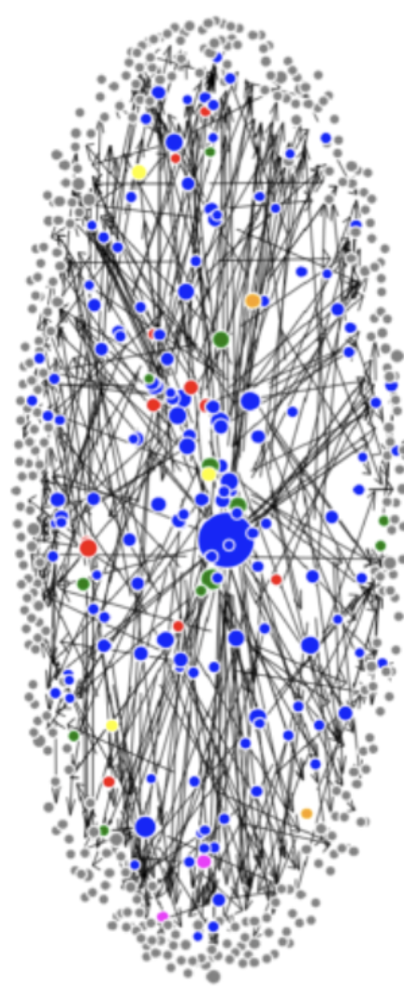
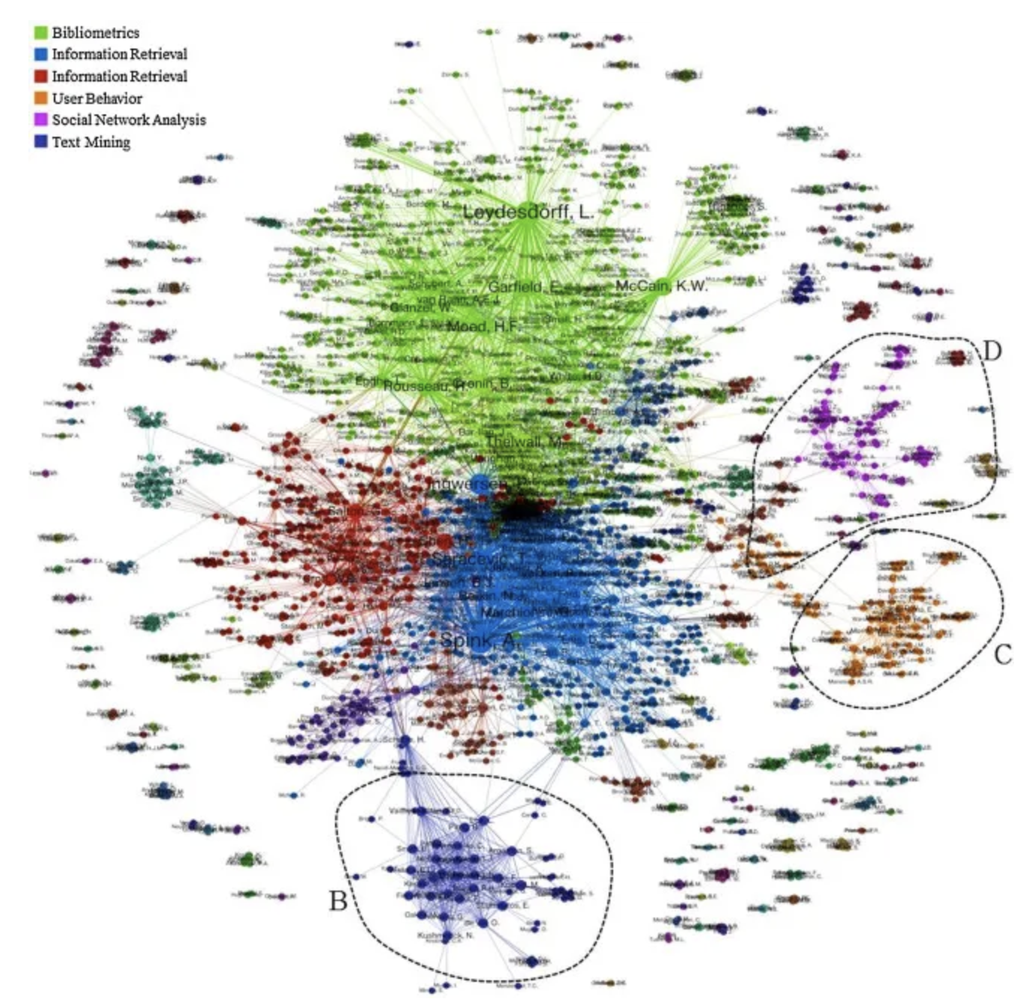
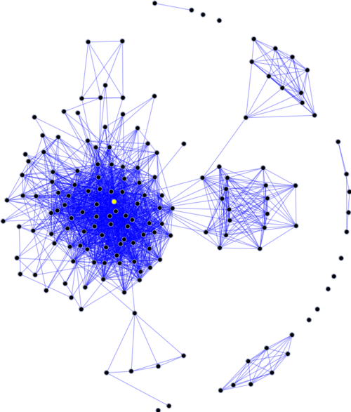
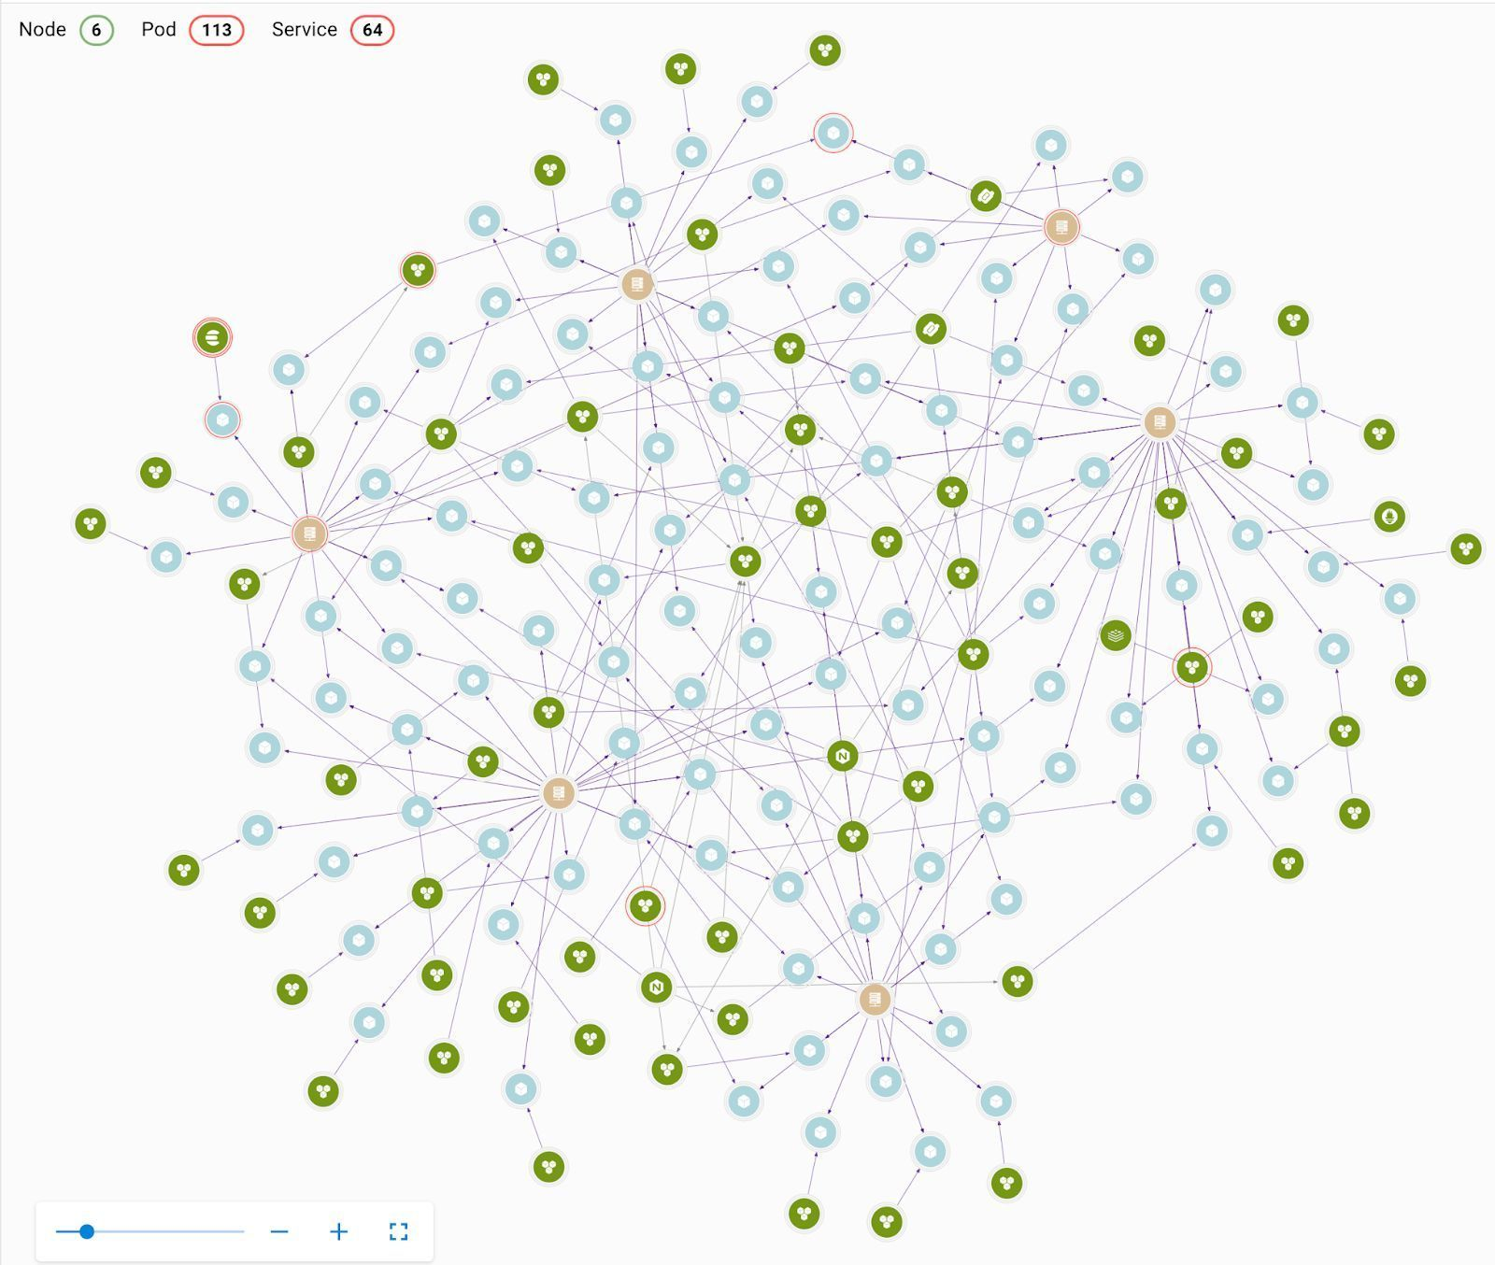
Hybrid Generative Models
M1
M2
Hybrid Language Model
…
Large Language Model
Knowledge Graph
Document Graph
Citation Graph
Social Graph

Slide 24
Why ‘Experiential’ AI?
Successful AI is not “set it and forget it.” Human intervention is the key to making AI work in the real world.
WHAT IS EXPERIENTIAL AI?
AI with a human in the loop, prioritizing the human experience.
ADVANCING AI THROUGH APPLIED WORK
We believe the biggest breakthroughs in the art and science of AI have come—and will come—through applied projects with real-world data that generate tangible results.
POSITIONED TO PARTNER On Solutions to Challenges
The Institute for Experiential AI exists at the frontier of applied AI and Engineering. We integrate industry expertise and talent pipelines to build pragmatic solutions to major AI challenges.

Slide 25
Some Questions
Why does Gen AI Work?
Will it change how we do science?
Is it worth the cost?
Why is there an obsession with larger models?
What are the risks?

Slide 26
Are bigger LLMs better?
Sample Case Study
in Finance

Slide 27
BloombergGPT: a finance-aware LLM
BloombergGPT, a 50-billion parameter large language model, purpose-built from scratch for finance [March 30, 2023]
BloombergGPT represents the first step in the development and application of this new technology for the financial industry.
Assists Bloomberg in improving existing financial NLP tasks, such as sentiment analysis, named entity recognition, news classification, and question answering, summarization, among others.
BloombergGPT: What? So What? Now what?
[BloombergGPT ARXIV: https://arxiv.org/abs/2303.17564 ]
Notes:
First mover

Slide 28
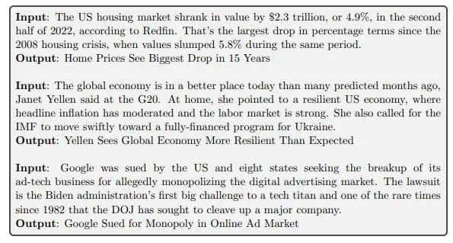
BloombergGPT: News headlines generator
INPUT
OUTPUT
INPUT
OUTPUT
INPUT
OUTPUT
Example: Bloomberg

Slide 29
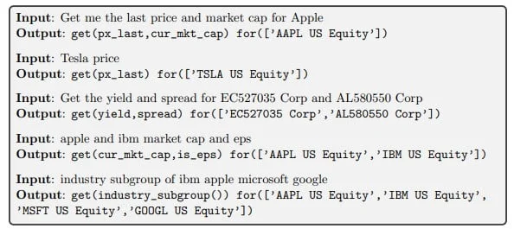
Generate Bloomberg queries (BQL) from natural language
The language model quickly learned Bloomberg’s BQL database language with just a few examples.
INPUT
OUTPUT
Example: Bloomberg
Notes:
formulate queries in Bloomberg’s own query language (BQL) to extract data from a database. You can use natural language to tell the model what data you need, and it’ll generate the appropriate BQL.

Slide 30
BloombergGPT: Some Questions
Why a 50-billion parameter large language model?
Because team had a “compute” budget of $3.5M
What is the significance BloombergGPT for Bloomberg?
Addressed some really important high-business value problems.
The approach generalized to many problems: sentiment analysis, named entity recognition, news classification, and question answering, summarization, among others.
BloombergGPT: What? So What? Now what?
[BloombergGPT ARXIV: https://arxiv.org/abs/2303.17564 ]
Notes:
First mover

Slide 31
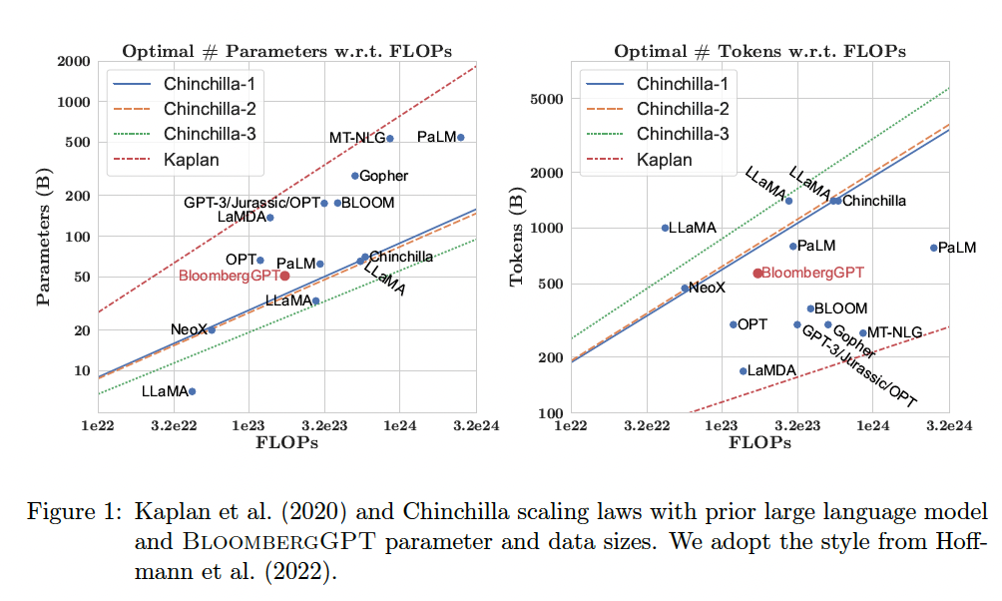
BloombergGPT: why a 50B LLM? And 700B tokens of training data?
LLM Size
Training Data Size
Interval
$3.5M compute budget
1.3M A100 GPU hours
2x10²³ FLOPS of compute
A100 has 100TF/s (10¹⁴): FP32
~100 machines X A100 has 100TF/s (10¹⁴)
100 X 10¹⁴ X 10⁷ seconds
~100 machines (with 8 A100 GPUs)
NOTE: M2 GPU13.6 FP32 TFLOPS (RTX3060 has similar perf.)
2x10²³ (quadrillion) FLOPS of compute budget for training ($3.5M)
[BloombergGPT ARXIV: https://arxiv.org/abs/2303.17564 ]

Slide 32
BloombergGPT: So what
[BloombergGPT ARXIV: https://arxiv.org/abs/2303.17564 ]
SO WHAT
This domain-specific language model allows Bloomberg to develop many new types of applications and achieve much higher performance than with custom models for each application - all with a faster time to market.
sentiment analysis
auto entity recognition
answering financial questions
summarization
headline generation
[BloombergGPT ARXIV: https://arxiv.org/abs/2303.17564 ]
Notes:
BloombergGPT shows new opportunities for marshalling the vast quantities of data available on the Bloomberg Terminal and elsewhere to better help Bloomberg’s customers, while bringing the full potential of AI to the financial domain. HITL is a key!
Keep it real. Dont get blinded by the hype.
Keeeeeee

Slide 33
Xfinance LLM 13B Outperforms BloombergGPT
Perform both unsupervised fine-tuning and instruction fine-tuning on the LLaMA 13B model (Stockastic.AI)
LLaMA 13B model
Fine-tune with Self-supervised
using finance articles
Fine-tune with instruction examples
Based on Question-Answer pairs
Fine-tuning on a GCP cluster of 8 A100 80GB GPUs over 24 hours at a cost of $1,000
Outperforms BloombergGPT on a range of financial applications
25% of the size of BloombergGPT
1000x cheaper? Much more?
More Robust, easier to maintain
Src 5/2023: https://www.stochastic.ai/blog/xfinance-vs-bloomberg-gpt
Notes:
BloombergGPT shows new opportunities for marshalling the vast quantities of data available on the Bloomberg Terminal and elsewhere to better help Bloomberg’s customers, while bringing the full potential of AI to the financial domain. HITL is a key!
Keep it real. Dont get blinded by the hype.
Keeeeeee

Slide 34


Generative AI: The good, the Bad, & the Ugly
The Good
The Bad
The Ugly
New Way to Search
Limited Context Window
Errors - “Hallucinations”
Productivity increases for knowledge workers
Loss of Factual Evidence
Data Confidentiality
Personalized Experiences
Misinformation Heaven
IP Rights and Issues
Variety of Applications
Heavy price in energy & compute infrastructure
Easy to hack
Less effort to produce results

Slide 35
Summary/Concluding Thoughts
AI is an enterprise imperative in the Digital Age, yet challenging to make work
It is a big factor in competitiveness in the knowledge economy
HOWEVER:
No Data ⇒ No working AI
Human intervention a must
Capture your IP: events, outcomes, context
continuous correction of algorithmic errors
More data means for AI/ML/Data Science needed to cope
Getting the data/context story right is the key enabler for business insights & AI

Slide 36
What else would I have liked to cover?
TS and Forecasting:
BigData
bigModels
And the importance of domain knowledge
The General Monitoring Problem
Wide applicability
Why AI is a must
And the need for humans in the loop

Slide 37


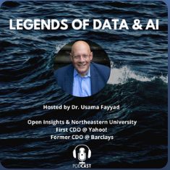


Thank you!
Questions?
Usama M. Fayyad
AI.northeastern.edu
www.open-insights.com
IEAI-NU
UFayyad
U.Fayyad@northeastern.edu
Assistant: R.Alshami@northeastern.edu
@Experiential_ai
@UsamaF
Legends of Data & AI
– Podcast – on Spotify and other platforms:
https://bit.ly/legendsofdata-ai
Institute for Experiential AI
Open Insights

Slide 38













Usama Fayyad, Executive Director, Institute for Experiential AI (EAI) at Northeastern University
Professor of the Practice, Khoury College for Computer Sciences, Northeastern University
Education
Large Orgs
Goal: Make AI and Data usable, useful, manageable - democratize the responsible use of AI across fields
Startups
Education
Ph.D. Computer Science & Engineering (CSE) in AI/Machine Learning
MSE (CSE), M.Sc. (Mathematics)
BSE (EE), BSE (Computer Engin)
Academic achievements
Fellow: Association for the Advancement of Artificial Intelligence (AAAI) and Association for Computing Machinery (ACM)
Over 100 technical articles on data mining, data science, AI/ML, and databases.
Over 20 patents, 2 technical books.
First in industry: Chief Data Officer at Yahoo!
First Global Chief Data Officer & Group Managing Director at Barclays Bank, London
Chaired/started major conferences in Data Science, Data Mining, AI
Founding Editor-in-Chief on two key journals in Data Science
Notes:
Usama Fayyad is the Executive Director of the Institute for Experiential AI at Northeastern University and Professor of the Practice at Khoury College of Computer Sciences. He also serves as Chairman of Open Insights, a data and technology and consulting firm he founded in 2008 after leaving Yahoo! where he served as the company’s first Chief Data Officer and founded Yahoo Research Labs.
Fayyad’s previous roles include Global Chief Data Officer at Barclays Bank and Founding Executive Chairman at Oasis500. He served as co-founder & CTO of OODA Health, held leadership roles at Microsoft and founded the Machine Learning Systems group at NASA’s
Jet Propulsion Laboratory, where his work on machine learning resulted in the top Excellence in Research award from Caltech and a U.S. Government medal from NASA.

